Slide 1
Dynamic Interest Rates Project Proposal
Dynamic Interest Scaling for FDs and Home Loans

Slide 2



Our team
Mohit Harsh
Mohith chowdary
Mahamani Nath
Backend
Development
Database
Management
Frontend
Development
AIML

Slide 3
Table of contents
01
04
02
05
03
06
About the project
Budget
High Level overview of the project
Estimated costs for solution implementation
Market Sizing
Project stages
Market share and valuation, of the focused sector
Stage by stage description of our project implementation
Proposed Solutions
Conclusion
Solution we propose to tackle the business problem
Conclusion of our work

Slide 4
01
About the project
Project Overview and Business use cases

Slide 5

Project Overview
Dynamic Interest Rate – Interest rates should be dynamically determined instead of being fixed.
AI-Powered Rate Suggestion – Use Gen AI to suggest optimal interest rates for both products.
Enhanced Decision-Making – The System should help banks improve competitiveness and customer satisfaction by offering optimized rates.
Personalized Recommendations – Rates should be adjusted based on customer profile, credit score, and other parameters.

Slide 6
What we are working on
Fixed Deposits
Home Loans
Risk-Management
Improve Loan Approval Rates
Enhance Profitability
Optimized Interest Rates Customer Retention Competitive Edge

Slide 7

Now
Build a Dynamic Interest Rate management system focused on Indian Market.

Slide 8

Future
Expand the system to others locations in the world and other related Industries.

Slide 9
02
Market Sizing

Slide 10
Market segmentation
Banks
Fintech
Public & Private Sector Banks, Regional & Cooperative Banks, Neobanks & Digital Banks
P2P Lending Platforms, AI-Powered Loan Aggregators
NBFCs
Govt. Bodies
HFCs, Mortgage Lenders & Housing Finance Firms, Investment & Deposit-Based NBFCs
Central Banks & Policy Makers, Public Sector Lending Institutions

Slide 11
Customer segmentation
Demographic
Behavioral
Age Group, Income Level, Employment Type, Marital Status
Investment Preferences, Loan Repayment Behaviour, Loan Tenure Preferences
Geographic
Psychographic
Urban, Semi-Urban, Rural Customers
Risk Appetite (Averse, Neutral, Tolerant), Tech-Savvy & Traditional Customers

Slide 12
$ 385.14 B
By 2033, the valuation of India Housing Finance Market is anticipated to reach $ 2,669.39 Billion.
@ customermarketinsights

Slide 13
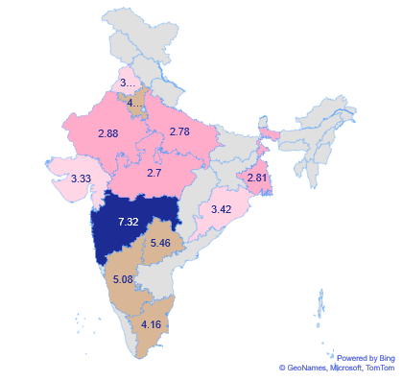
Fixed Deposits - 2023
Low
Avg. Fixed Deposit Investment is 2.7 – 3.4 Lakhs
Medium
Avg. Fixed Deposit Investment is
3.4 – 5.08 Lakhs
High
Avg. Fixed Deposit Investment is
5.08 – 7.32 Lakhs

Slide 14
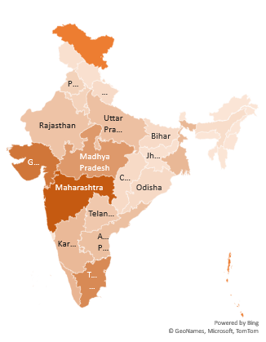
Home Loans - 2023
Min
Lakshadweep : 255
Avg
Avg. Home Loan Accounts per State : 4,34,053
Max
Maharashtra : 12,25,539

Slide 15
Interest Rates
6.5%
Highest
6.5% is the Highest Interest Rate in past 5 years.
4.0%
Lowest
4.0% is the Lowest Interest Rate in past 5 years.
6.5%
Current
6.5% is the Current Interest Rate in 2025.

Slide 16
03
Proposed Solutions

Slide 17
Proposed Solutions
Mathematical
Gen AI
ML
Rule-Based Framework
Completely AI-Driven
Solution
Supervised
Machine Learning
Model

Slide 18
Mathematical Approach
This method involves a structured, rule-based framework where predefined adjustments are applied to the base interest rate based on specific credit-related parameters.
The decision rules are structured with the assistance of Generative AI, while the final rate modifications are manually determined.
Pros
Simple, structured, and easy to interpret.
Transparent decision-making process.
Does not require large datasets for training.
Predictable and consistent results
Cons
Manual intervention needed for updating rate adjustments.
Limited ability to capture complex, nonlinear patterns in data.

Slide 19
Gen - AI Approach
In this model, a foundational interest rate and key influencing parameters are embedded into an AI prompt.
The AI then analyzes these inputs and generates an optimal interest rate dynamically, eliminating the need for manual adjustments.
Pros
Dynamic rate generation based on real-time input conditions.
Reduces manual intervention in decision-making.
Can incorporate complex financial scenarios and reasoning.
Cons
Results may lack consistency across multiple queries.
May not always align with regulatory compliance.

Slide 20
Machine Learning Approach
A supervised learning model is trained using historical financial data, incorporating multiple parameters such as credit score, income, loan-to-value ratio, and past repayment behavior.
The trained model predicts the final interest rate based on data-driven patterns, enabling an adaptive and automated decision-making process.
Pros
Data-driven and continuously improves with new financial data.
Captures intricate patterns and trends in financial behavior.
Minimizes manual decision-making and enhances automation.
Cons
Requires a large and high-quality dataset for training.
Needs continuous monitoring and retraining for optimal performance.

Slide 21
Key Features
Dynamic Rates
AI Assistant
Forecast Rates
Dynamic Interest Rate Calculation System
AI Chatbot to provide Statistical and Economic Insights for better decision making
Time Series Forecasting algorithm to predict future interest rates for risk management.

Slide 22
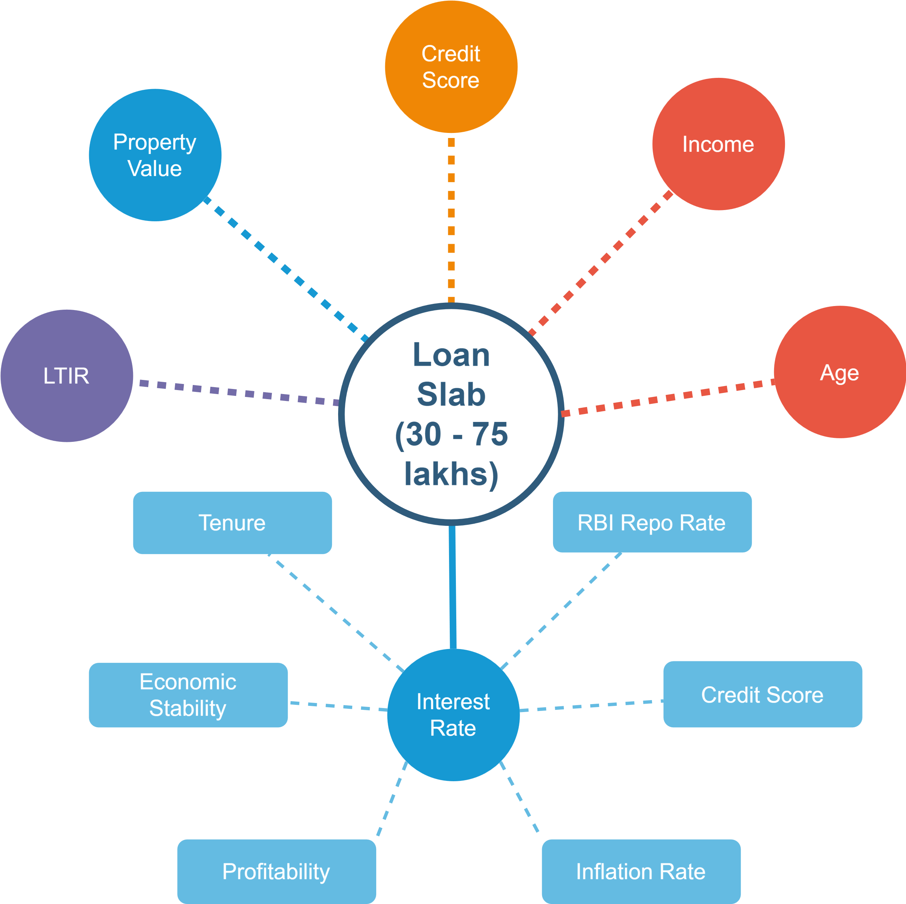
Workflow
Home Loan Eligibility Calculation
Age of the Borrower
Loan-to-Income Ratio
Credit Score
Property Value
Annual Income of the customer
Home Loan Interest Rates
Dynamically Calculate the Interest rate based on the following factors:
Total Tenure of the loan
RBI Repo Rate
Credit Score of the Customer
Profitability Margin of the Company
Inflation Rate of the state
Economic Stability of the customer

Slide 23
Credit Score
Factor | Weight (%)
Credit History | 35%
Loan – Debt History | 30%
Financial History | 15%
Personal Demographic | 10%
Feature Category | Features
Personal & Demographic | Age, Employment Type, Annual Income, Gender
Credit History & Behavior | Payment History, Credit Utilization Ratio, Loan Default Count
Loan & Debt-Related Features | Number of Active Loans, Total Loan Amount, Debt-to-Income Ratio
Financial Transactions | Monthly Savings, Average Bank Balance, Spending Behavior

Slide 24
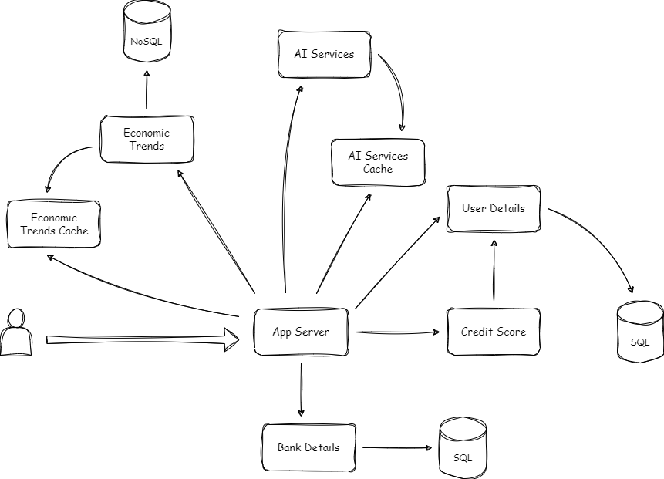
System Design

Slide 25
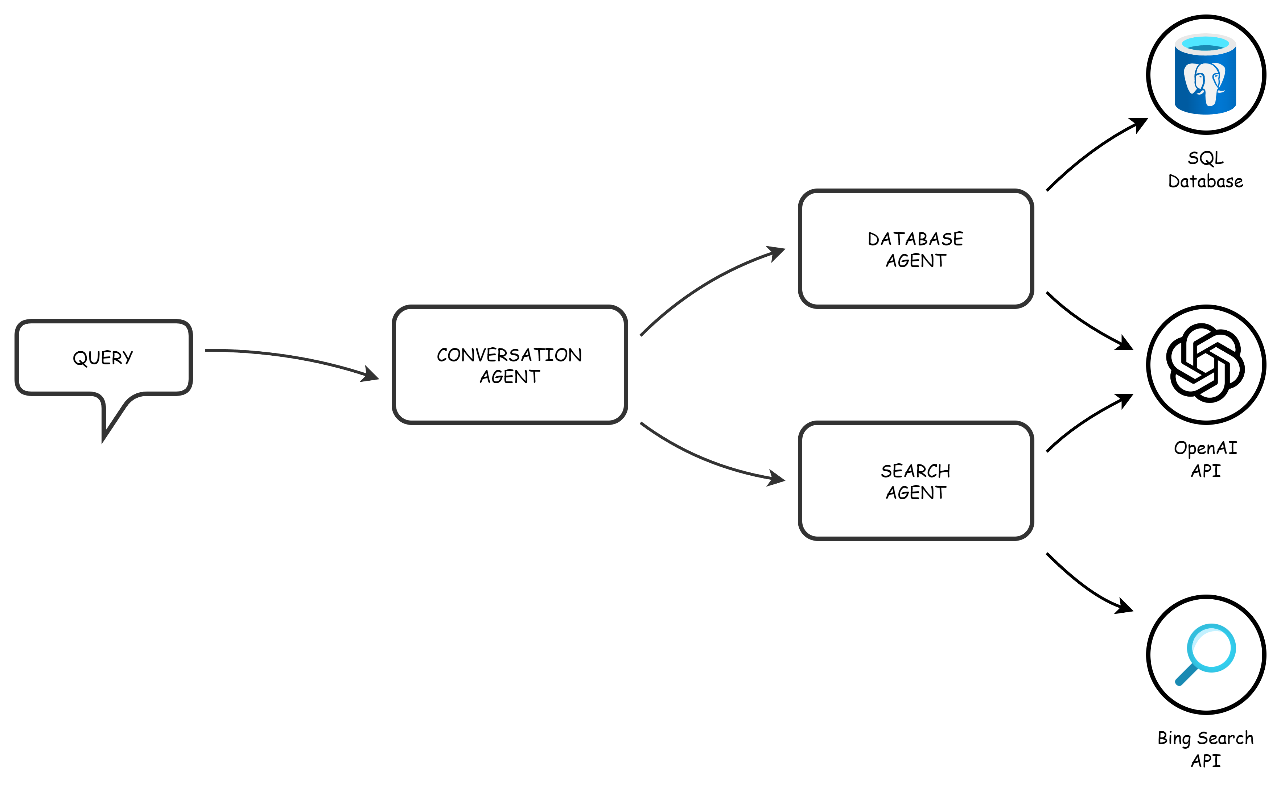
AI Assistant

Slide 26
Deployment
Web App
Desktop App
Mobile App
Frontend
React.js
Backend
Spring Boot
Fast API
Frontend
Electron.js
Backend
Spring Boot
Fast API
Frontend
Electron.js
Backend
Spring Boot
Fast API

Slide 27
04
Budget

Slide 28
Major requirements
Storage
Security
Database (SQL, NoSQL), Data Warehouse
Oauth, Azure Key Vault
APIs
Scaling
OpenAI API,
Bing Search API
Manual or Event Based Scaling
Web Servers
Backup
Azure App Service
Cold Storage, Backup Servers

Slide 29
Budget
$ 5
$ 25,000
Development
Deployment
Development and Integrating features
Deployement on Azure Cloud
$ 10
$ 10,000
Testing
Marketing
Testing with API’s and Training models
Digital Marketing and Ads

Slide 30
Business & financial analysis
Investments | Development | Testing | Deployment | Marketing
Storage | $ 0.00 | $ 1.00 | $ 110.00 | -
Compute | $ 0.00 | $ 3.00 | $ 365.00 | -
Security | $ 0.00 | $ 1.00 | $ 11.00 | -
API’s | $ 5.00 | $ 5.00 | $ 23,625.00 | -
Ads | - | - | - | $ 10,000
Total | $ 5.00 | $ 10.00 | $ 24,111.00 | $ 10,000
Financial Analysis Spreadsheet

Slide 31
05
Project Stages

Slide 32
Pilot Testing
Partner with a regional bank to deploy the MVP. Gather feedback to refine risk models and forecasting algorithms.
Market Launch:
Roll out the full solution with a targeted go-to-market strategy. Support banks in transitioning from static to dynamic pricing.
02
04
01
03
05
Research & Development
Validate model assumptions with historical data. Build a minimum viable product (MVP) of the dynamic pricing engine.
Iteration and Scaling
Integrate advanced analytics and user-friendly dashboards. Enhance API integration to support multi-product functionality.
Expansion & Diversification:
Extend the solution’s capabilities to additional financial products. Continuously update the system with real-time data feeds and regulatory insights.

Slide 33
Current Timeline
UI/UX
Testing
Design Of Frontend for Desktop App and Web App
Testing of application after deployment
Feb
April
May
June
Backend
Security
Development of Centralized Backend server and Databases
Implementation of Security practices after integration with Backend

Slide 34
06
Conclusion

Slide 35
Project Outcomes
Dynamic Rates
Competitive Rates
Transparency
Risk Management
Dynamic Interest Rate Calculation System
Maintain a balance between competitive market rates and profitability
Enable transparency in rate calculation to build customer trust.
Mitigate risks associated with high-risk borrowers while ensuring fair interest rates for all customers.

Slide 36


